Slide 2
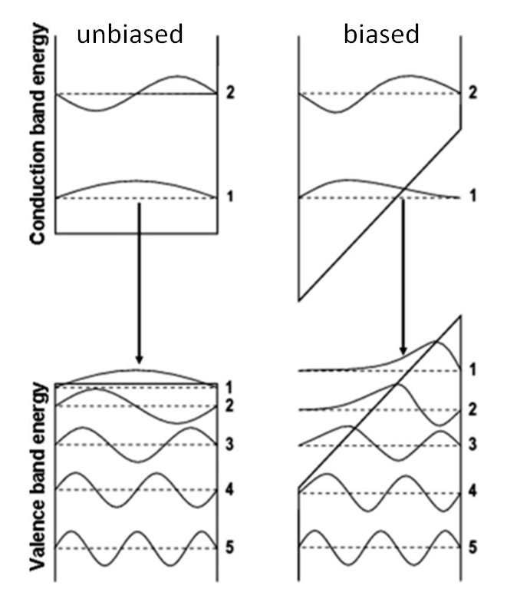
E
E
X
X

Slide 3
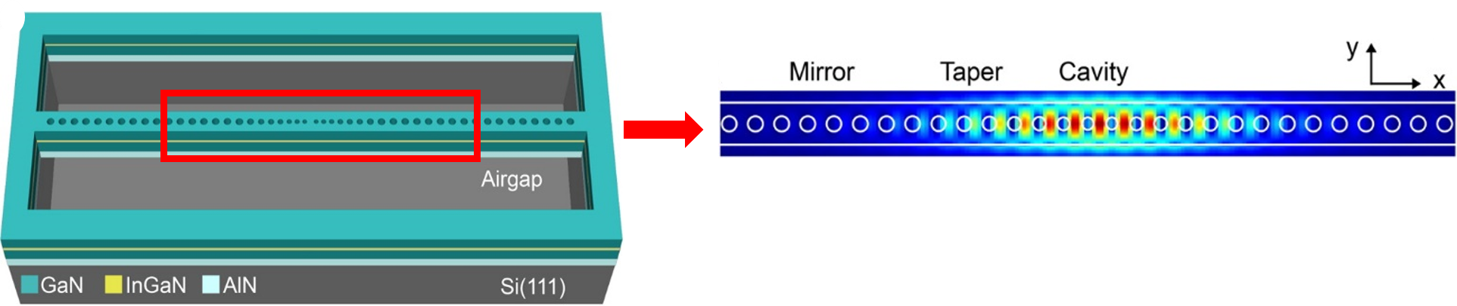
Mirror
Taper
Cavity
Tapering of the nanobeam holes

